Slide 1
기계학습 및 딥러닝 처리를 위한 Plotly 및 Matplotlib 소개

Slide 2
머신러닝과 딥러닝을 위한 Python 기본 라이블러리
Numpy
https://numpy.org/
Scipy
https://www.scipy.org/
Pandas
https://pandas.pydata.org/
Plotly
https://plotly.com/
Matplotlib
https://matplotlib.org/

Slide 3
Plotly
makes interactive, publication-quality graphs
how to make line plots, scatter plots, area charts, bar charts, error bars, box plots, histograms, heatmaps, subplots, multiple-axes, polar charts, and bubble charts.
Free open source
Pip install plotly

Slide 4
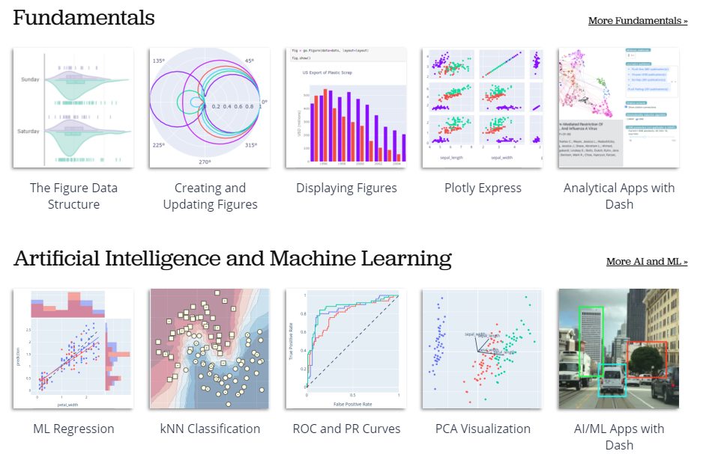
Plotly

Slide 5
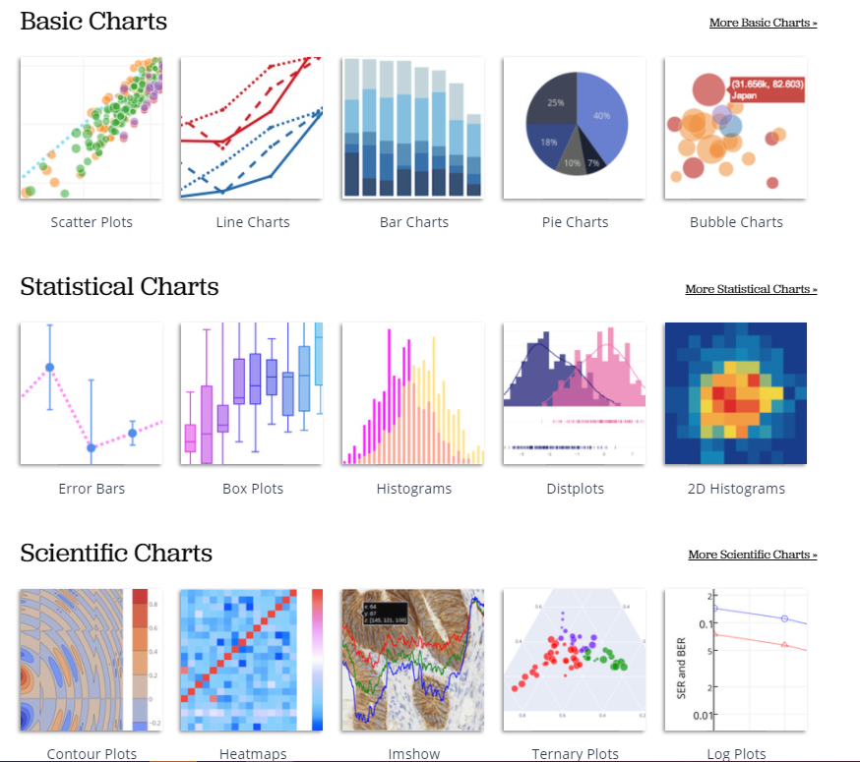
Plotly

Slide 6
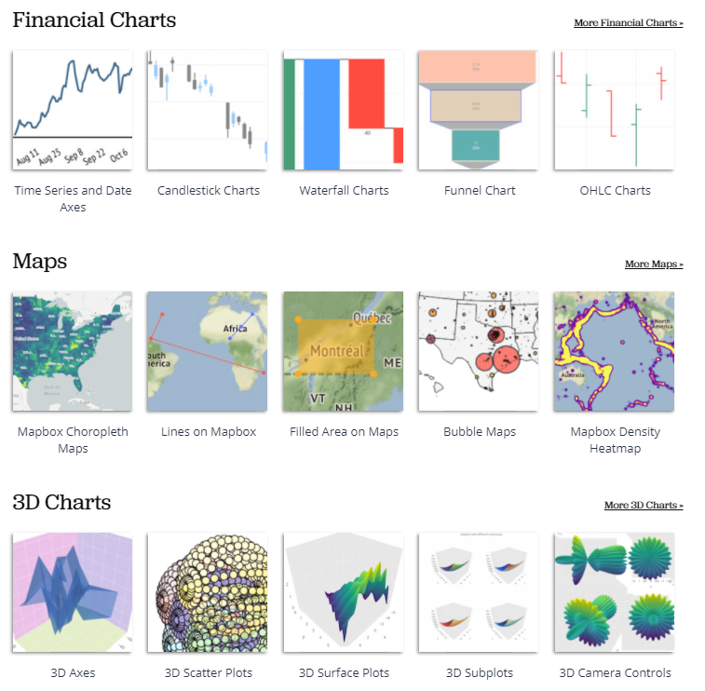
plotly

Slide 7
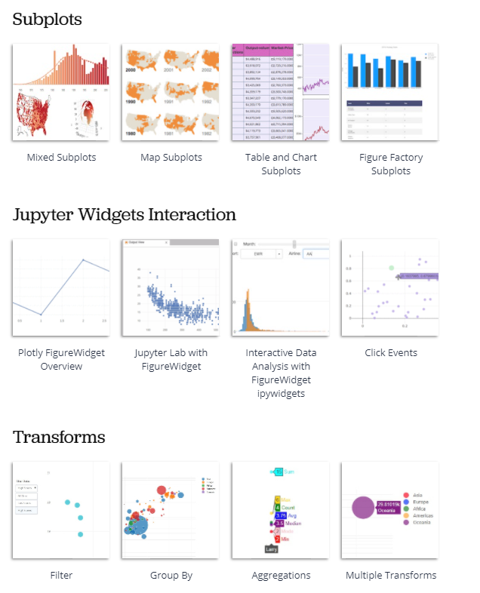
Plotly

Slide 8
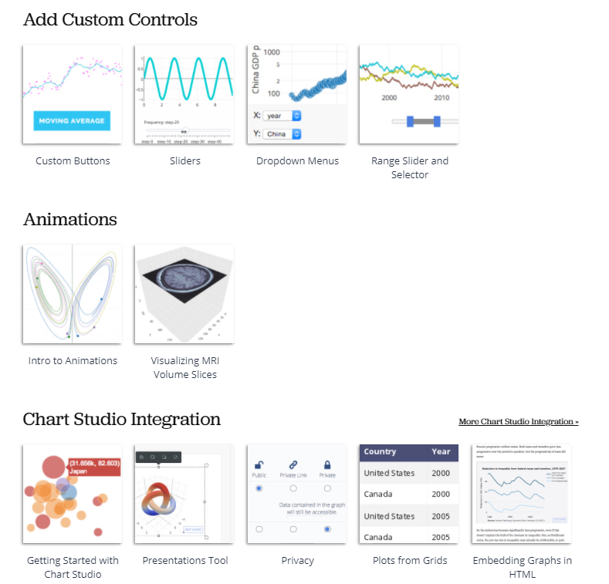
Plotly

Slide 9
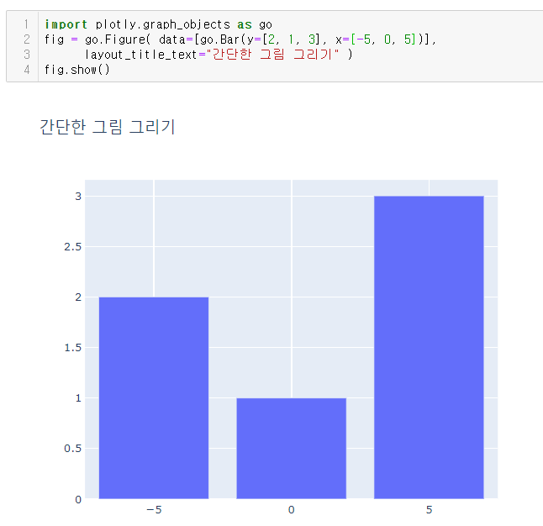
Plotly 그래프 그리기

Slide 10
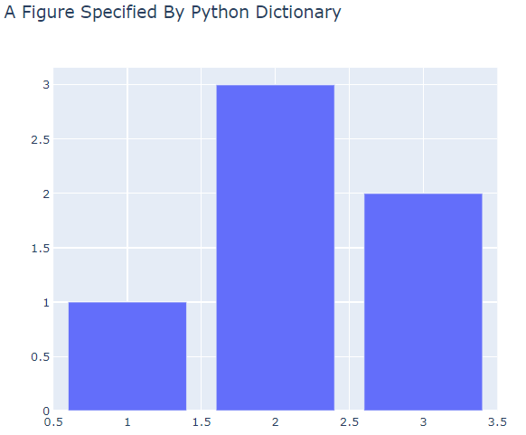
Plotly 그래프 그리기
fig = dict({
"data": [{"type": "bar",
"x": [1, 2, 3],
"y": [1, 3, 2]}],
"layout": {"title": {"text": "A Figure Specified By Python Dictionary"}}
})
import plotly.io as pio
pio.show(fig)

Slide 11
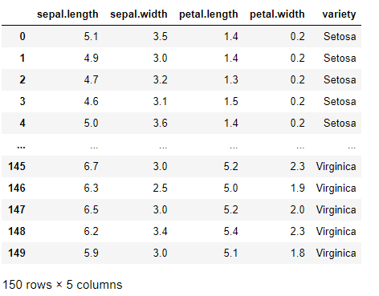
Plotly 그래프 그리기
import pandas as pd
Iris_data = pd.read_csv("iris.csv")
Iris_data

Slide 12
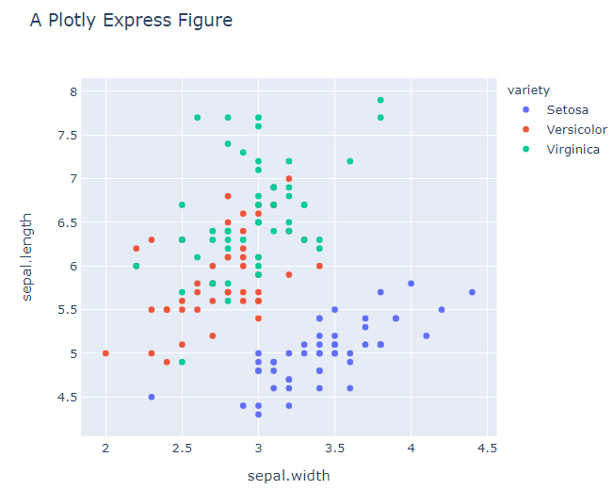
import plotly.express as px
fig = px.scatter(Iris_data, x="sepal.width", y="sepal.length", color="variety", title="A Plotly Express Figure")
fig.show()

Slide 13
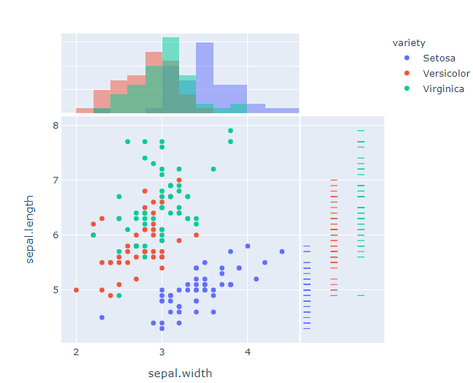
Plotly 그래프 그리기
import plotly.express as px
fig = px.scatter(Iris_data, x="sepal.width", y="sepal.length", color="variety",
marginal_y="rug", marginal_x="histogram")
fig.show()

Slide 14
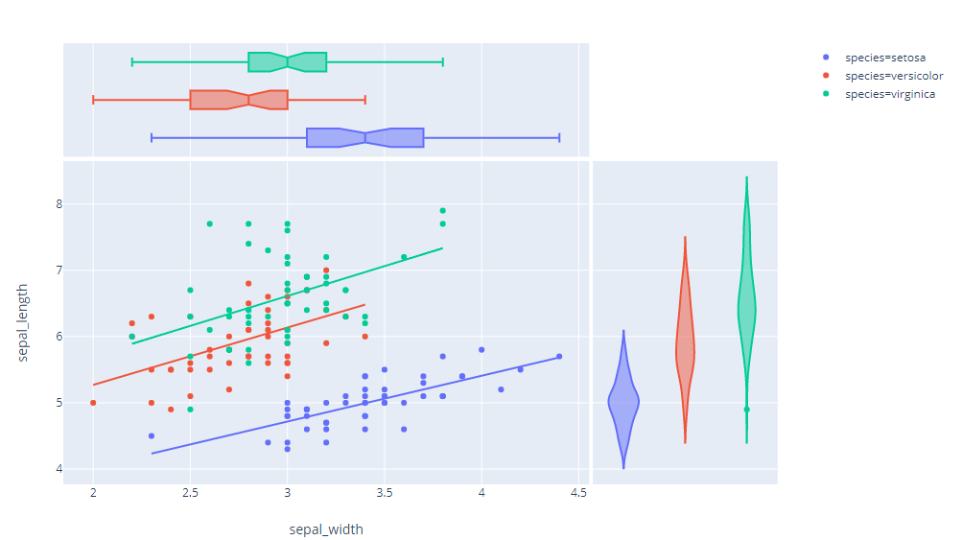
Plotly 그래프 그리기
fig = px.scatter(Iris_data, x="sepal.width", y="sepal.length", color="variety",
marginal_y="violin", marginal_x="box", trendline="ols")
fig.show()

Slide 15
Plotly 그래프 그리기
fig = px.scatter(Iris_data, x="sepal.width", y="sepal.length", color="variety", facet_col="variety", title="Adding Traces To Subplots Witin A Plotly Express Figure")
reference_line = go.Scatter(x=[2, 4],
y=[4, 8],
mode="lines",
line=go.scatter.Line(color="gray"),
showlegend=False)
fig.add_trace(reference_line, row=1, col=1)
fig.add_trace(reference_line, row=1, col=2)
fig.add_trace(reference_line, row=1, col=3)
fig.show()

Slide 16
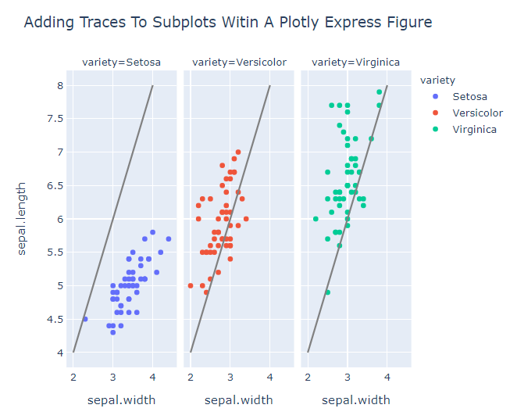

Slide 17
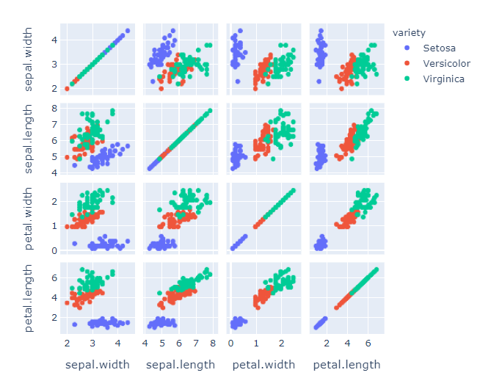
Plotly 그래프 그리기
fig = px.scatter_matrix(Iris_data, dimensions=["sepal.width", "sepal.length", "petal.width", "petal.length"], color="variety")
fig.show()

Slide 18
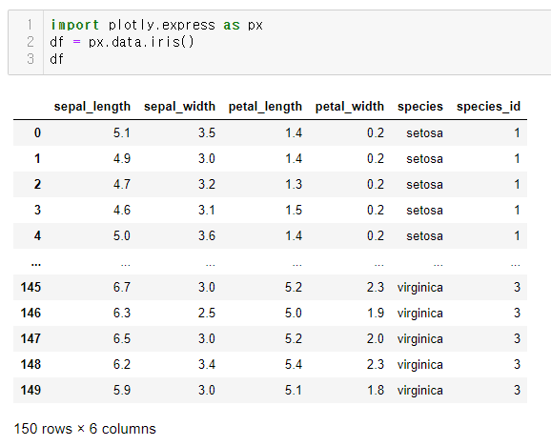

Slide 19
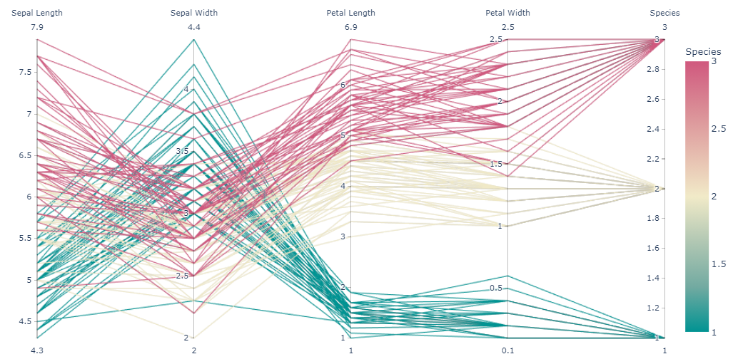
import plotly.express as px
df = px.data.iris()
fig = px.parallel_coordinates(df, color="species_id", labels={"species_id": "Species",
"sepal_width": "Sepal Width", "sepal_length": "Sepal Length",
"petal_width": "Petal Width", "petal_length": "Petal Length", },
color_continuous_scale=px.colors.diverging.Tealrose, color_continuous_midpoint=2)
fig.show()

Slide 20
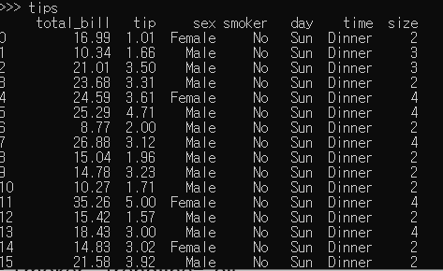
Plotly 그래프 그리기
total_bill: 총 합계 요금표
tip: 팁
sex: 성별
smoker: 흡연자 여부
day: 요일
time: 식사 시간
size: 식사 인원
import plotly.express as px
tips_data = px.data.tips()

Slide 21
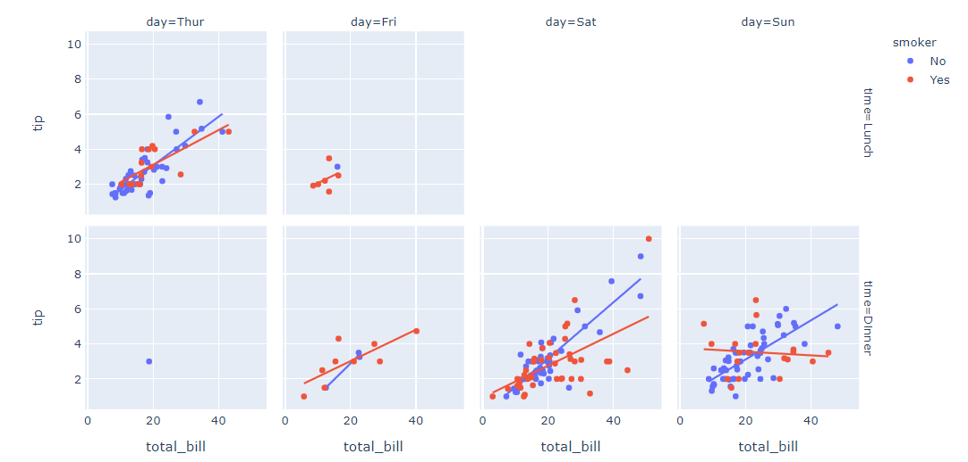
Plotly 그래프 그리기
import plotly.express as px
tips = px.data.tips()
fig = px.scatter(tips, x="total_bill", y="tip", facet_row="time",
facet_col="day", color="smoker", trendline="ols",
category_orders={"day": ["Thur", "Fri", "Sat", "Sun"], "time": ["Lunch", "Dinner"]})
fig.show()

Slide 22
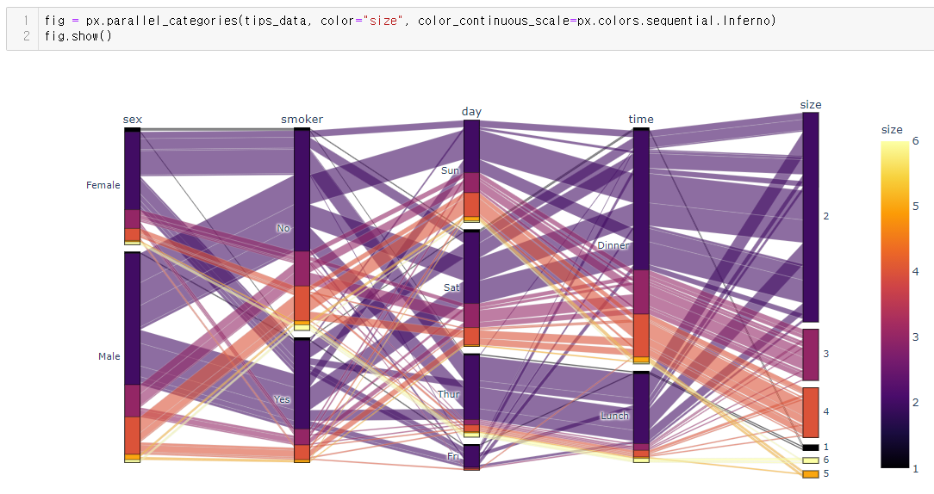

Slide 23
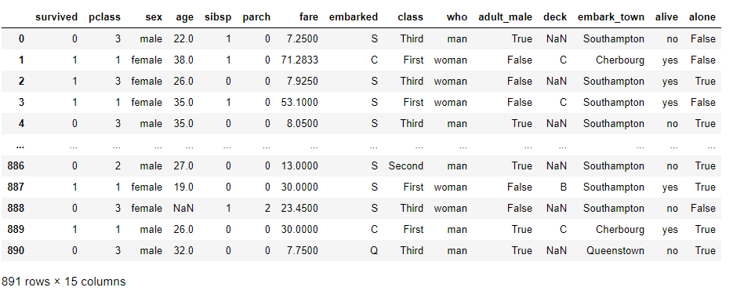
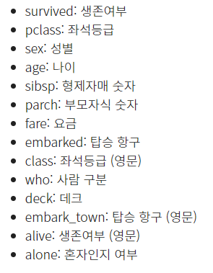
titanic_data = pd.read_excel("titanic.xlsx")
titanic_data

Slide 24
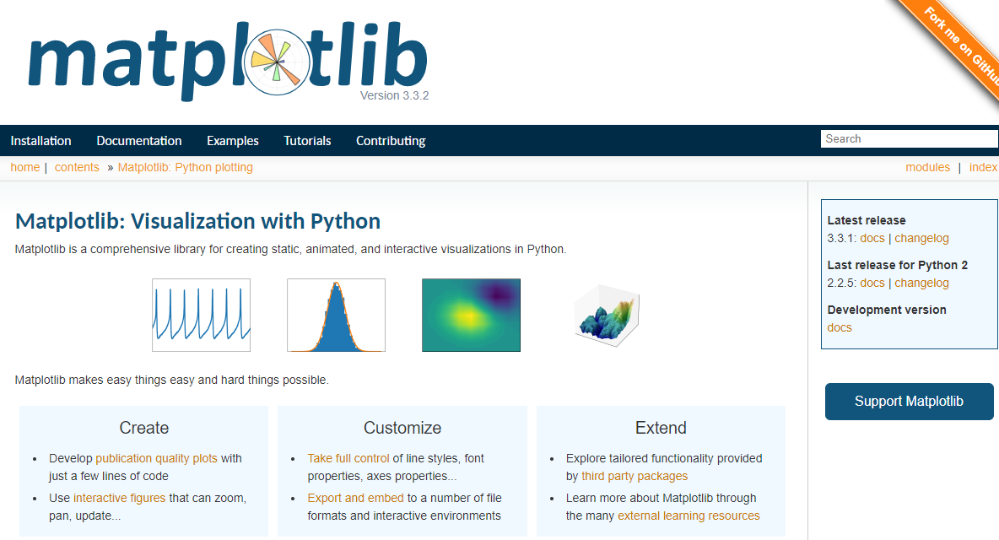
Matplotlib
a comprehensive library for creating static, animated, and interactive visualizations in Python.
https://matplotlib.org/

Slide 25
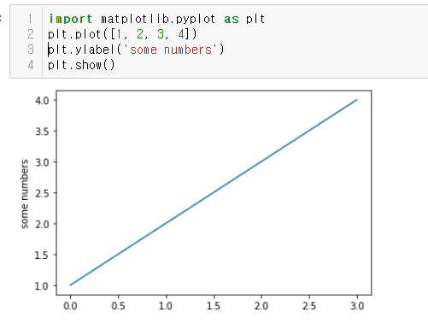
Matplotlib를 이용한 그리기

Slide 26
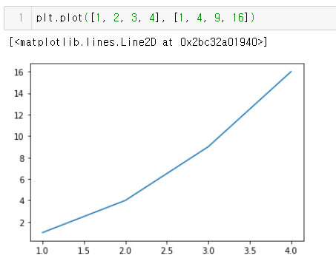
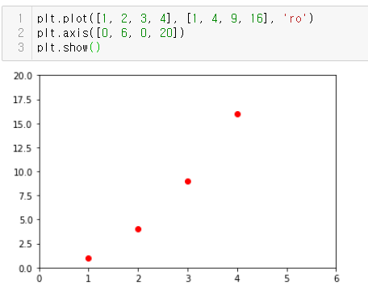

Slide 27
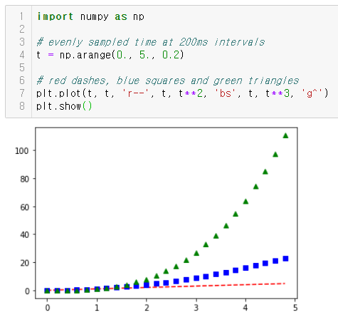

Slide 28
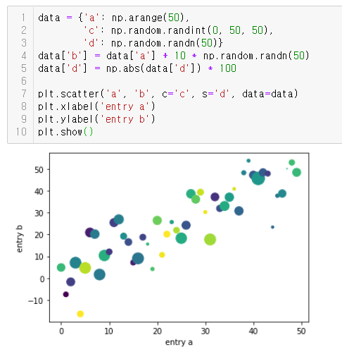

Slide 29
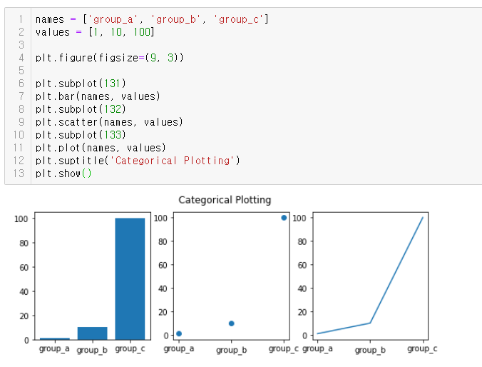

Slide 30
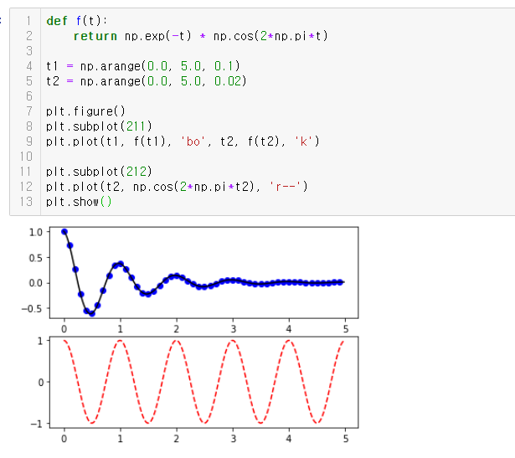

Slide 31
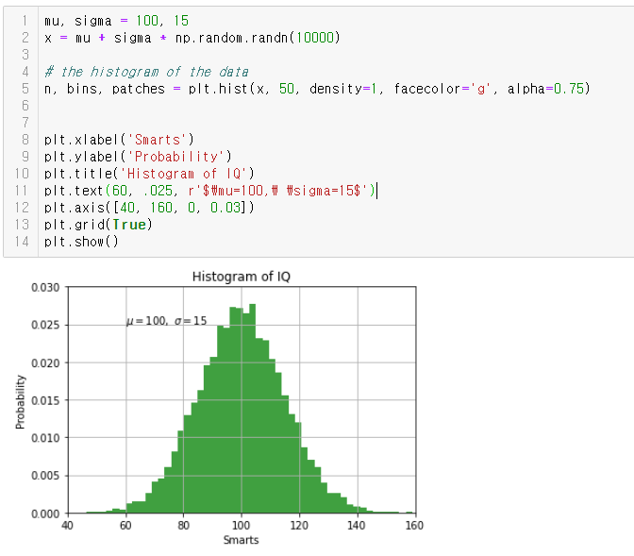

Slide 32
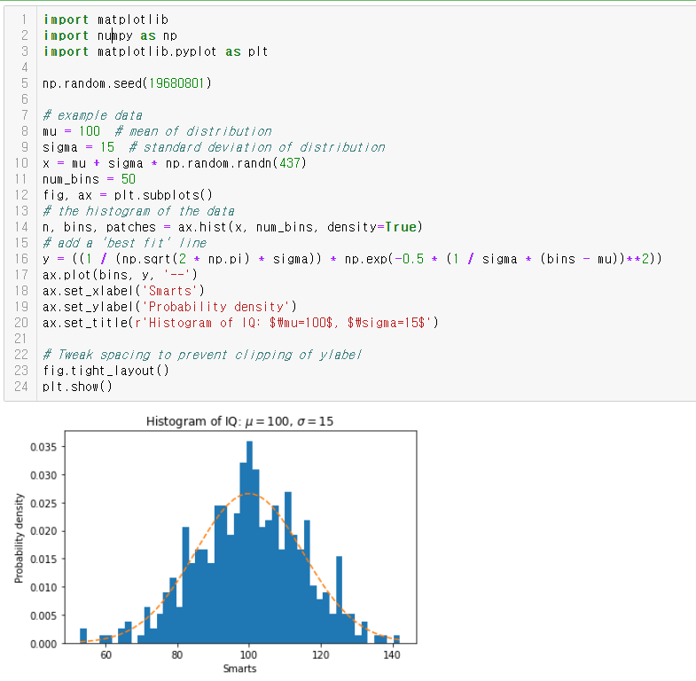

Slide 33
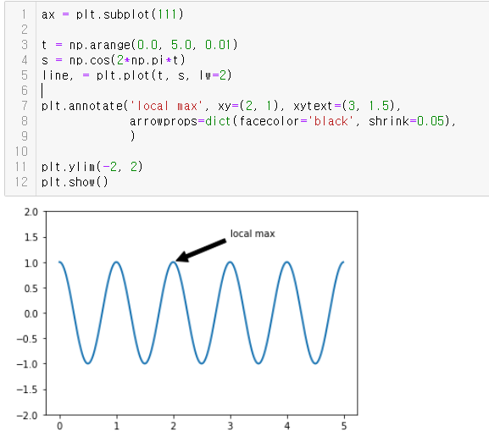

Slide 34
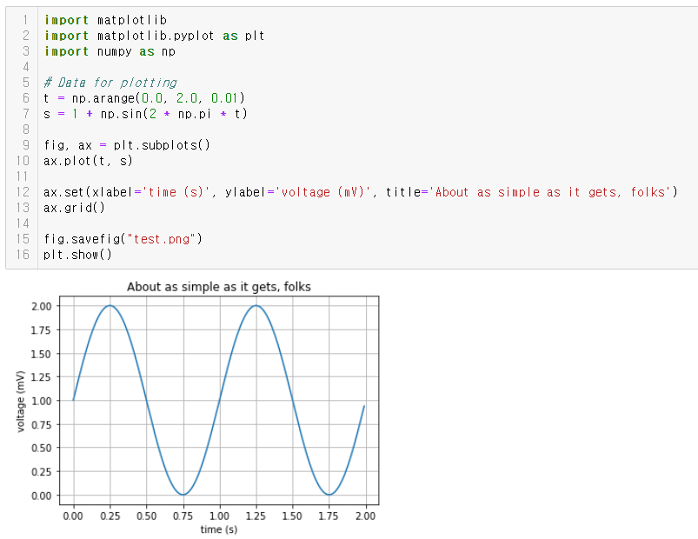

Slide 35
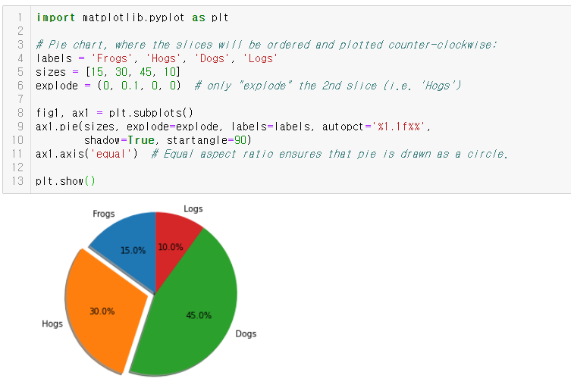

Slide 36
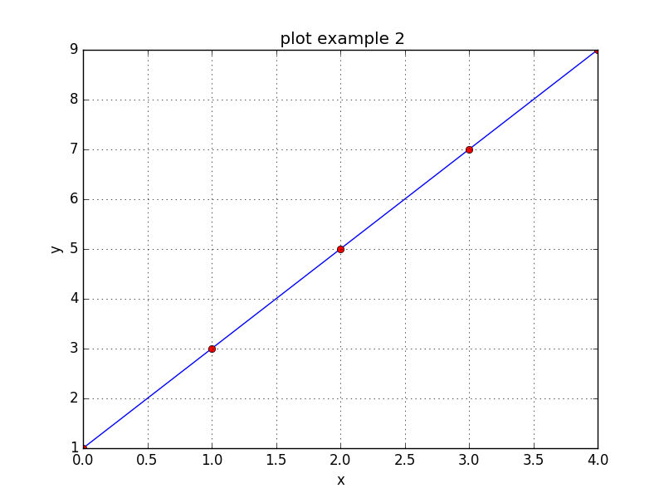
라인그리기2
import numpy as np
import matplotlib.pyplot as plt
x = np.arange(5)
y = np.array([1, 3, 5, 7, 9])
plt.plot(x, y, "b-", x, y, "ro")
plt.xlabel("x")
plt.ylabel("y")
plt.title(" plot example 2")
plt.grid(True)
plt.savefig(“line.png")
plt.show()

Slide 37
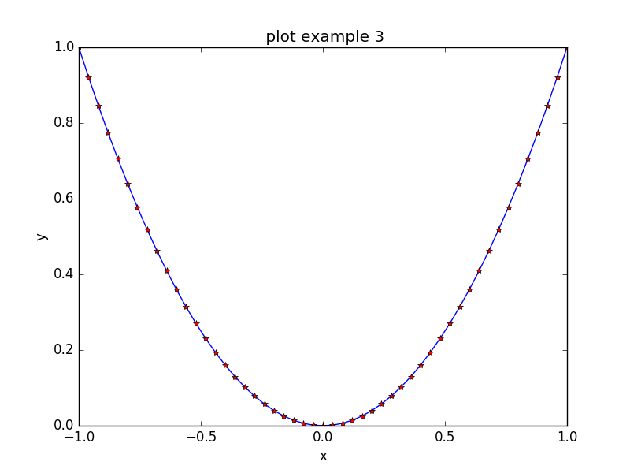
X, Y 축의 범위 설정
import numpy as np
import matplotlib.pyplot as plt
x = np.linspace(start = -1, stop = 1, num=51)
y = x**2
plt.plot(x, y, 'b-', x, y, 'r*')
plt.axis([-1, 1, 0, 1])
plt.xlabel("x")
plt.ylabel("y")
plt.title(" plot example 3")
plt.savefig("ex0951.png")
plt.show()

Slide 38
y=sin(x)
import numpy as np
import matplotlib.pyplot as plt
x = np.linspace(0, 2*np.pi, num=51)
y = np.sin(x)
line = plt.plot(x, y)
xmin, xmax, ymin, ymax = np.amin(x), np.amax(x), -1, 1
plt.axis([xmin, xmax, ymin, ymax])
#plt.xlim(xmin, xmax)
#plt.ylim(ymin, ymax)
plt.plot([xmin, xmax], [0, 0], color='black', linewidth=4.0)

Slide 39
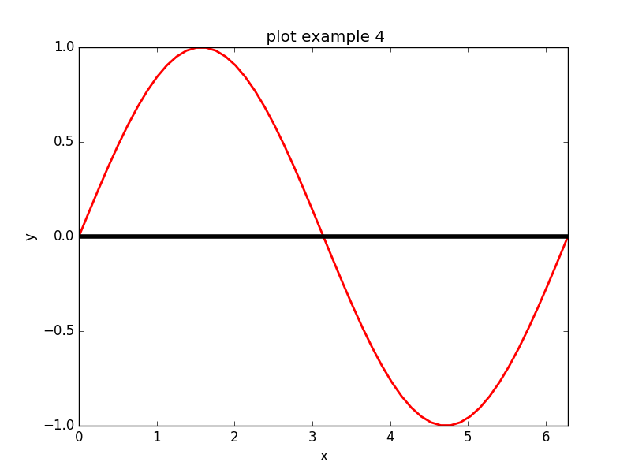
y=sin(x)
plt.setp(line, color='red', linewidth=2.0)
plt.xlabel("x")
plt.ylabel("y")
plt.title(" plot example 4")
plt.savefig(“sine.png")
plt.show()

Slide 40
y1=sin(x), y2=cos(x), 범례생성
import numpy as np
import matplotlib.pyplot as plt
x = np.linspace(0, 2*np.pi, num=101)
y1, y2 = np.sin(x), np.cos(x)
plt.plot(x, y1, "k--", label = "y1 = sin(x)")
plt.plot(x, y2, "b-", label = "y2 = cos(x)")
xmin, xmax, ymin, ymax = x[0], x[-1], -1, 1

Slide 41
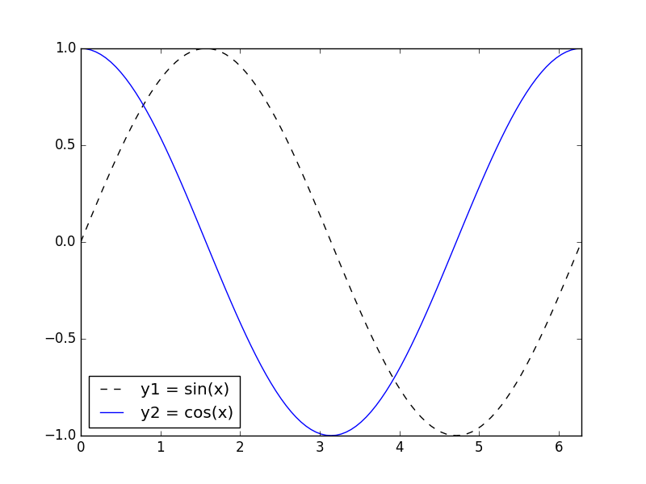
y1=sin(x), y2=cos(x), 범례생성
plt.axis([xmin, xmax, ymin, ymax])
#plt.xlim(xmin, xmax)
#plt.ylim(ymin, ymax)
plt.legend(loc="best")
plt.savefig(“sincos.png")
plt.show()

Slide 42
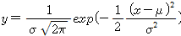
1D 정규분포 N(0, sigma)
import numpy as np
import matplotlib.pyplot as plt
def gauss(mu, sigma, x):
y = 1.0/(sigma*np.sqrt(2 * np.pi ))*np.exp(-((x - mu)**2)/(2*sigma**2))
return y
mu, sigma= 0, 2
x = np.linspace(-4*sigma, 4*sigma, num=101)
y1 = gauss(mu, sigma, x)
plt.plot(x, y1, color = "#ff0000", label = "sigma = 2")

Slide 43
1D 정규분포 N(0, sigma)
mu, sigma= 0, 1
y2 = gauss(mu, sigma, x)
plt.plot(x, y2, color = "#00ff00", label = "sigma = 1")
mu, sigma= 0, 0.5
y3 = gauss(mu, sigma, x)
plt.plot(x, y3, color = "#0000ff", label = "sigma = 0.5")
plt.title(" Normal dist. N(0, sigma)")
plt.legend(loc="best")
plt.savefig(“norm1d.png")

Slide 44
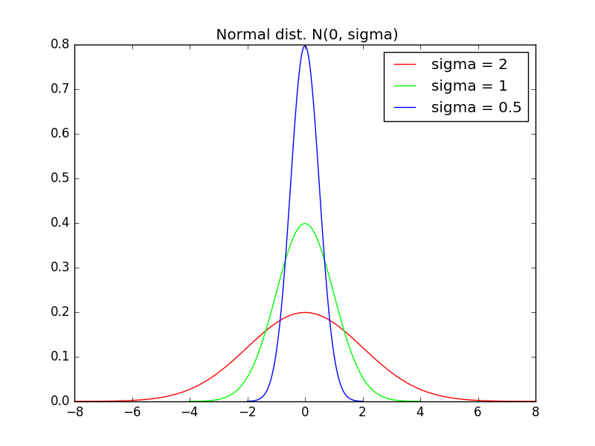
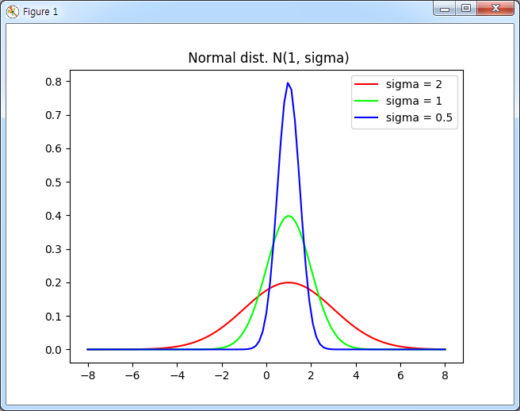
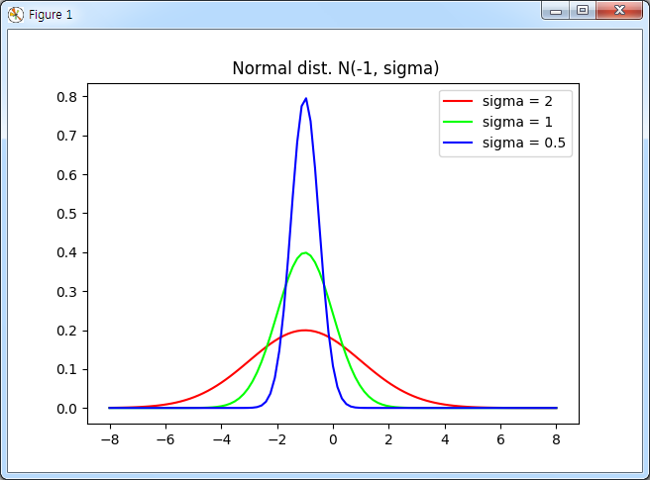
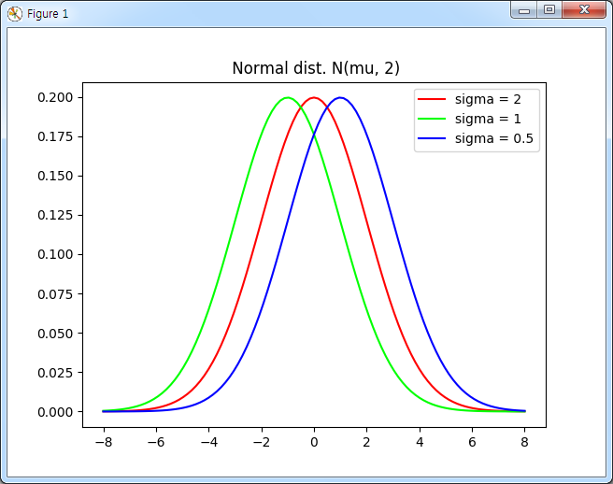
1D 정규분포 그래프

Slide 45
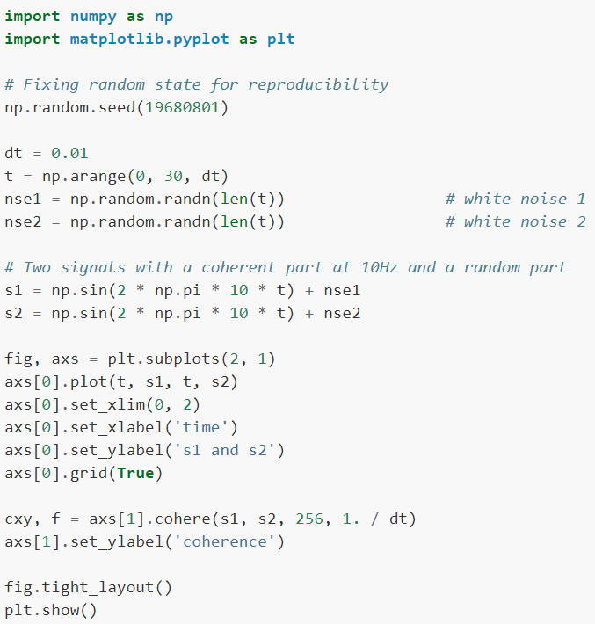
Plotting the coherence of two signals

Slide 46
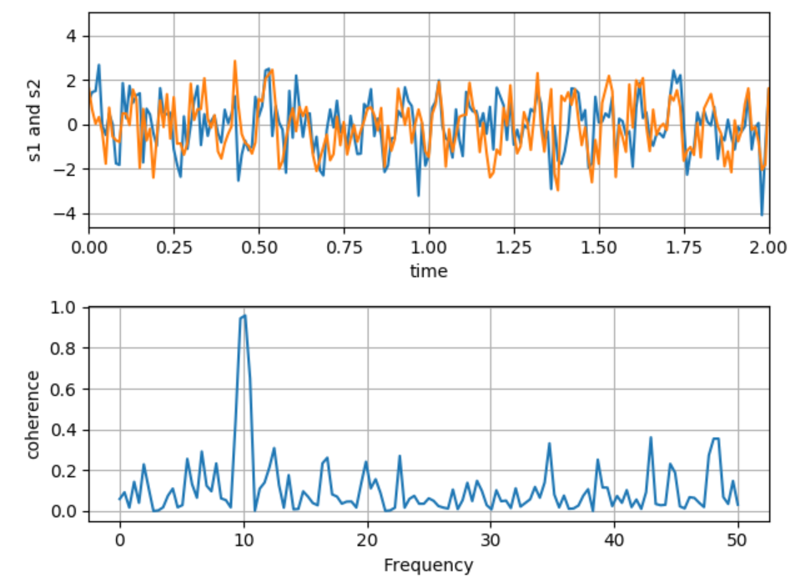
Plotting the coherence of two signals

Slide 47
직선의 최소자승해
import numpy as np
import matplotlib.pyplot as plt
x = np.linspace(-10.0, 10.0, num=51)
m, c = 3, -10 # Truth
y = m*x + c
e = np.random.normal(0, 10.0, x.size) # noise
y1 = y + e
A = np.vstack([x, np.ones(len(x))]).T
p, residuals, r, s = np.linalg.lstsq(A, y1)
m1, c1 = p # Estimate
y2 = m1*x + c1

Slide 48
직선의 최소자승해
plt.plot(x, y, "b-", label = "y = 3x - 10")
plt.plot(x, y1, "ko", label = "y1 = 3x - 10 + N(0, 10.0)")
plt.plot(x, y2, "r-", label = "y2 = {:+.2f}x {:+.2f}".format(m1, c1))
plt.title(" Leaset square solution: residuals {:.2f}".format(residuals[0]))
plt.legend(loc="best")
plt.savefig(＂lineFit.png")
plt.show()

Slide 49
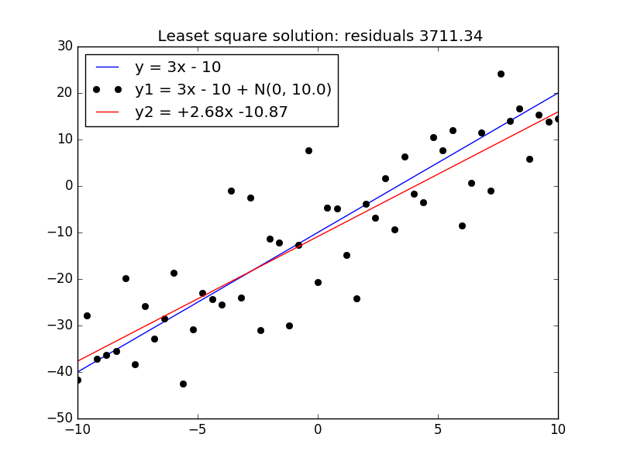
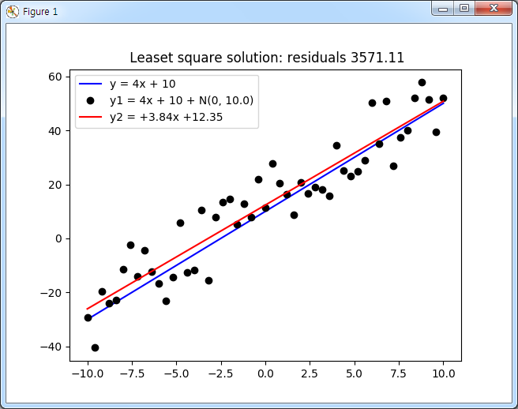
직선의 최소자승해

Slide 50
직선의 최소자승해
plt.plot(x, y, "b-", label = "y = 3x - 10")
plt.plot(x, y1, "ko", label = "y1 = 3x - 10 + N(0, 10.0)")
plt.plot(x, y2, "r-", label = "y2 = {:+.2f}x {:+.2f}".format(m1, c1))
plt.title(" Leaset square solution: residuals {:.2f}".format(residuals[0]))
plt.legend(loc="best")
plt.savefig(＂lineFit.png")
plt.show()

Slide 51
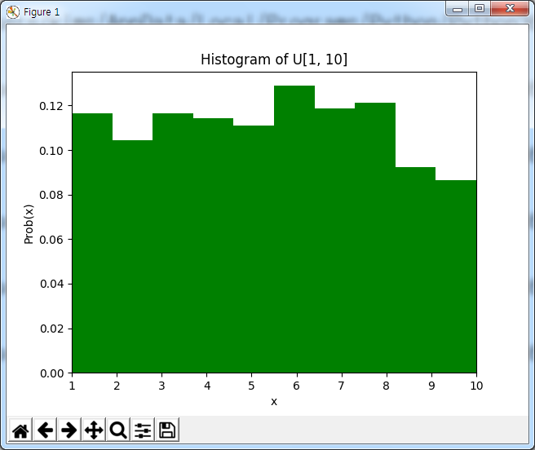
균등분포의 히스토그램
import numpy as np
import matplotlib.pyplot as plt
x = np.random.random_integers(1, 10, size=1000)
n, bins, patches = plt.hist(x, 10, normed=True, color='g')
print(np.sum(n*np.diff(bins)))
xmin, xmax = np.amin(x), np.amax(x)
plt.xlim(xmin, xmax)
plt.xlabel("x")
plt.ylabel('Prob(x)')
plt.title("Histogram of U[1, 10]")
plt.show()

Slide 52
정규분포의 히스토그램
import numpy as np
import matplotlib.pyplot as plt
mu, sigma = 10, 1
x = mu + sigma * np.random.randn(10000)
n, bins, patches = plt.hist(x, 50, normed=True, color='g', label = 'hist')
print(np.sum(n*np.diff(bins)))
pdf = n*np.diff(bins)
print(np.sum(pdf))
middle_x = bins[:-1] + np.diff(bins)/2
plt.plot(middle_x, pdf, 'r-', linewidth=1.5, label='pdf')

Slide 53
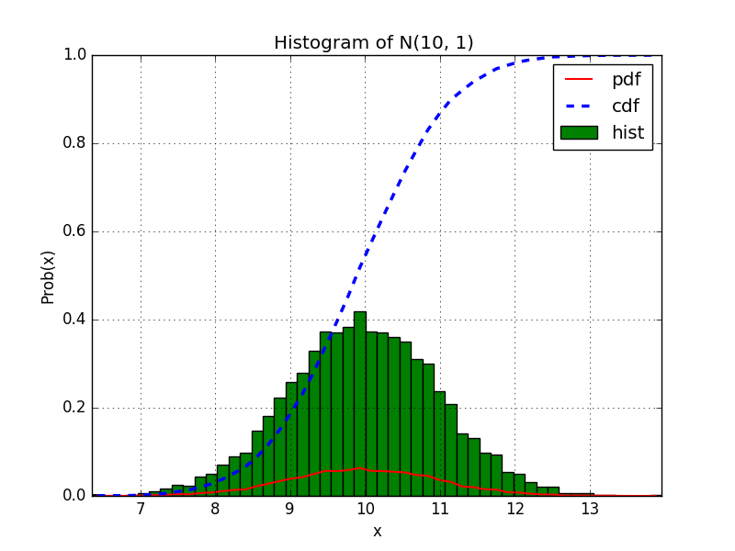
정규분포의 히스토그램
cdf = np.cumsum(pdf)
#cdf /= cdf[-1]
plt.plot(middle_x, cdf, 'b--', linewidth=2.5, label='cdf')
xmin, xmax = np.amin(x), np.amax(x)
plt.xlim(xmin, xmax)
plt.xlabel("x")
plt.ylabel('Prob(x)')
plt.title("Histogram of N(10, 1) ")
plt.grid(True)
plt.legend(loc="best")
plt.show()

Slide 54
산포도 그리기
import numpy as np
import matplotlib.pyplot as plt
ax.add_patch( patches.Rectangle( (0.1, 0.4), 0.2, 0.2,
fill=False, linestyle='dashed', linewidth=2))
plt.rc('figure', figsize=(6, 6)) # plt.rcParams['figure.figsize'] = (6, 6)
fig, ax = plt.subplots(2, 2)
fig.suptitle("Scatter diagram")
ax[0][0].plot(x, y, "o")
ax[0][1].scatter(x, y, color='b', s=10, marker='+')

Slide 55
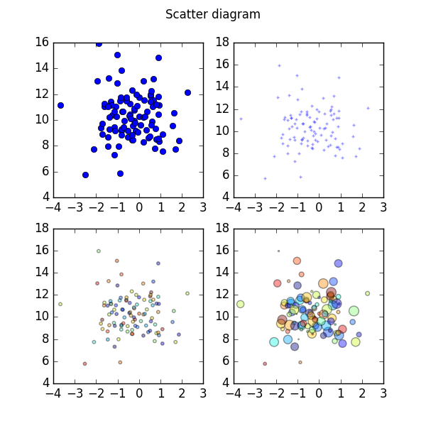
산포도 그리기
colors = np.random.rand(N)
ax[1][0].scatter(x, y, c=colors, s=10, marker='o', alpha=.4)
size1 = np.random.random_integers(1, 100, size=N)
ax[1][1].scatter(x, y, c=colors, s=size1, marker='o', alpha=.4)
plt.savefig(＂scatter.png")
plt.show()

Slide 56

영상 입출력
import matplotlib.pyplot as plt
import matplotlib.image as img
image = img.imread("C:/Users/Public/Pictures/SamplePictures/Desert.jpg")
print("image.shape =", image.shape)
plt.imshow(image)
img.imsave(＂desert1.png＂, image)
#plt.savefig(＂desert2.png＂)
plt.show()

Slide 57
애니메이션: sine 그래프
import numpy as np
from matplotlib import pyplot as plt
from matplotlib import animation
fig = plt.figure()
ax = plt.axes(xlim=(0, 2), ylim=(-2, 2))
line, = ax.plot([], [], lw=2)
def init():
line.set_data([], [])
return line,

Slide 58
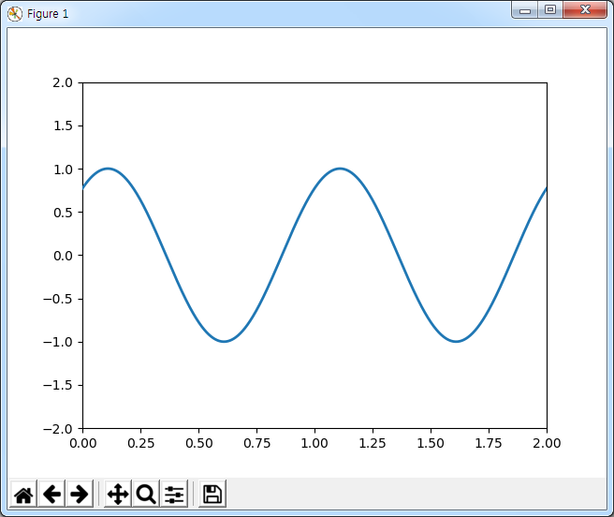
애니메이션: sine 그래프
def animate(i):
## print("i=", i)
x = np.linspace(0, 2, 1000)
y = np.sin(2 * np.pi * (x - 0.01 * i))
line.set_data(x, y)
return line,
anim = animation.FuncAnimation(fig, animate, init_func=init,
frames=200, interval=20, blit=True)
plt.show()

Slide 59

애니메이션: moving circle,
import numpy as np
import matplotlib.pyplot as plt
import matplotlib.animation as animation
fig = plt.figure()
line, = plt.plot([], [], "b-o", markersize= 10,lw=2)
x1 = np.linspace(-5, 5, num=101)
y1 = 0.5*x1**3+x1**2+x1*2
xmax, xmin = 10, -10
ymax, ymin = max(y1), min(y1)
…… 채워 보세요.

Slide 60
Gradient Decent Alg.
import numpy as np
import matplotlib.pyplot as plt
x_old = 0
x_new = 3 # The algorithm starts at x=6
eps = 0.01 # step size
precision = 0.001
def f(x):
## return x**4 -3*x**3 + 2
## return (3*x - 2)*(x + 2)**2
return 2.5 + 10/np.pi * np.sin(np.pi*x/4)

Slide 61
Gradient Decent Alg.
##def f_prime(x):
## return 4 * x**3 - 9 * x**2
def dx(f, x):
h = 0.001
return (f(x+h) - f(x))/h
while abs(x_new - x_old) > precision:
x_old = x_new
## x_new = x_old - eps * f_prime(x_old)
x_new = x_old - eps * dx(f, x_old)
print("f(%s) = %s"%(x_new, f(x_new) ) )

Slide 62

Gradient Decent Alg.
x = np.linspace(0, 2*np.pi, num = 101)
plt.plot(x, f(x), color='blue')
##plt.plot(x, dx(f, x), color = 'red')
plt.plot([x_new], [f(x_new)], "go")
plt.show()
#실행결과
f(3.0176846097164773) = 4.719312422396786
f(3.0356129425749163) = 4.686963231516396
…..
f(5.948920729447565) = -0.6805377353958311
f(5.949913589895848) = -0.6806363195365486

Slide 63
Perceptron
import numpy as np
from matplotlib import pyplot as plt
def perceptron_sgd(X, Y):
w = np.random.rand(len(X[0])) #w=np.zeros(len(X[0]))
eta = 0.1
epochs = 20
for t in range(epochs):
for i, x in enumerate(X):
if (np.dot(X[i], w)*Y[i]) <= 0:
w = w + eta*X[i]*Y[i]
print("t =%s: w=%s"%(t, w))
return w

Slide 64
Perceptron
#main
y = np.array([-1,-1,1,1,1])
X = np.array([
[-2,4,-1],
[4,1,-1],
[1, 6, -1],
[2, 4, -1],
[6, 2, -1]])
w = perceptron_sgd(X,y)
print(w)
# 그래프를 그려 보세요.

Slide 65

Perceptron
t =0: w=[0.57984404 0.47003589 0.61982447]
t =1: w=[0.47984404 0.57003589 0.71982447]
t =2: w=[0.37984404 0.67003589 0.81982447]
….
t =19: w=[0.17984404 0.17003589 1.01982447]

Slide 66


Slide 67
감사합니다.

